Slide 1
Maximizer CRM Live 2019 R5
Demo Script

Slide 2
What’s New in R5
Enhancements to the Leads Module
User-defined fields for leads
Field mapping and data transfer
Processes and stages
Industry, Source and No. of Employees fields
Customize column view
Filter in Leads module
Other New Features
Allow more than 255 characters in task Activity field
Custom password complexity rules
Not allow duplicate primary email address for users
Disable settings of system generated user-defined fields
Email URLs for mobile apps to mobile device
New version of Outlook add-in
If you are running Maximizer CRM Financial Advisor edition, some of the labels in your application are not the same as the labels displayed in this document. Use the chart below to match the labels in this document with the labels in Financial Advisor edition.
Labels in Financial Advisor Edition Labels in this document
Contact List Address Book
Households Individuals
Accounts Opportunities
Client Service Customer Service

Slide 3
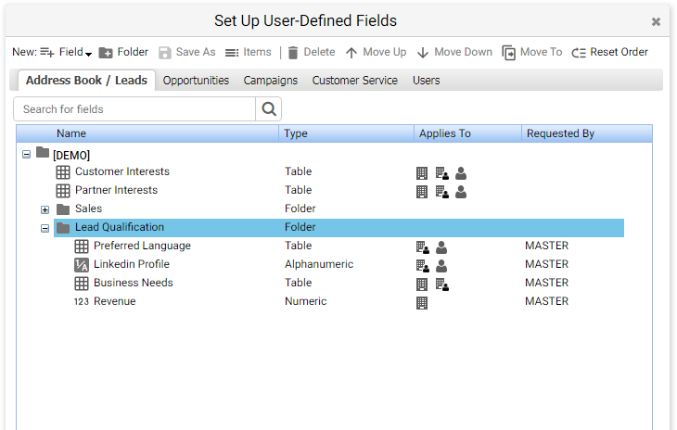
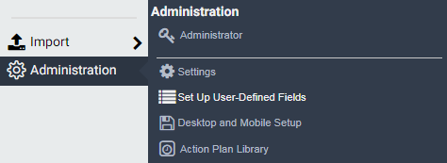
User-Defined Fields for Leads
If you used to track and qualify leads in Address Book module, you may have created user-defined fields for that purpose already. Now you would like to switch to the Leads module. You can easily make the existing fields available to leads so you don’t need to re-create them.
Go to Icon Bar > Administration > Set Up User-Defined Fields.
Address Book tab has been changed to Address Book / Leads.
In Set Up User-Defined Fields dialog, you will notice that the Address Book tab has been renamed to Address Book / Leads. In this tab, you can make the existing fields available to leads or create new fields only for leads.
Note
The supported field types for leads include: alphanumeric, numeric, date, and table. Duration, formula and yes/no types are not supported in this release.
Applies To is a new column which shows the entry types assigned to each field.
The User-Defined Fields section in Administrator module has been removed in this release.

Slide 4
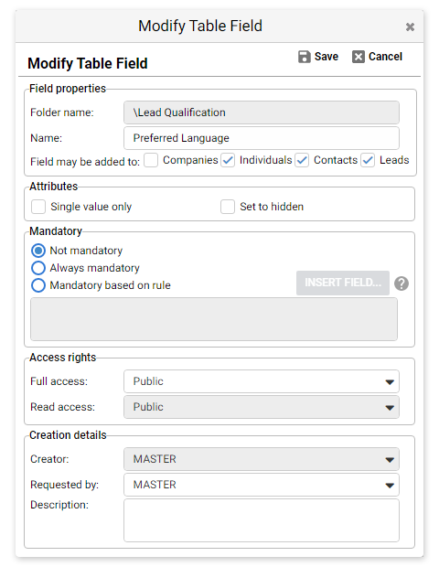
Make an existing Address Book field available to leads
Open an existing Address Book field that you would like to share with leads, check the checkbox for Leads. Note When a field is set to be available to both Address Book entries and leads, the value in the lead will be copied to the field in Address Book entry during lead conversion.
Mandatory rule If Always mandatory is selected, the field will be mandatory for both Address Book entries and leads. Mandatory based on rule is only applied to Address Book entries. Do not select this option if the field is available to leads.
Check this checkbox to make the field available to leads.

Slide 5
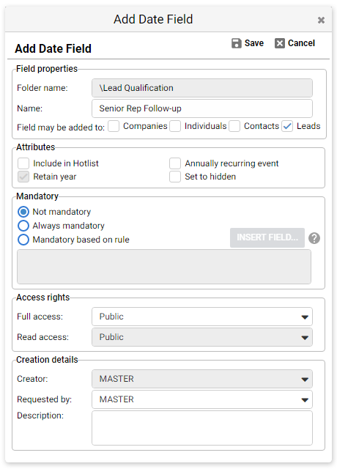
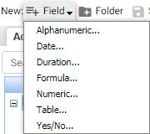
Create a new field for leads
You can create a new field only for leads. From the New Field drop-down, select a field type.
In the Add Field dialog, uncheck all the Address Book entry types and select Leads.
Uncheck Address Book entry types and select Leads to make the field only available to leads.

Slide 6
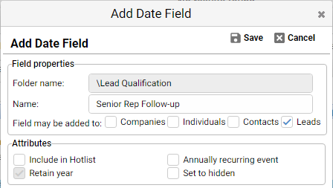
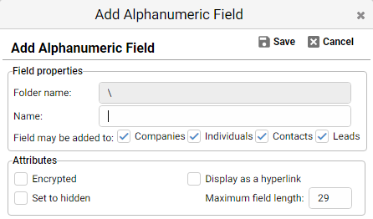
Attributes not supported in fields for leads
Some of the attributes are not supported if a field is available to leads.
Date field
In a date field, Include in Hotlist and Annual recurring event should not be selected if the field is available to leads.
Alphanumeric field
In an alphanumeric field, Encrypted should not be selected if the field is available to leads.
New default setting
Table field
When creating a table field, Single value only will be selected by default.
Include in Hotlist and Annual recurring event shouldn’t be selected.
Encrypted shouldn’t be selected.

Slide 7
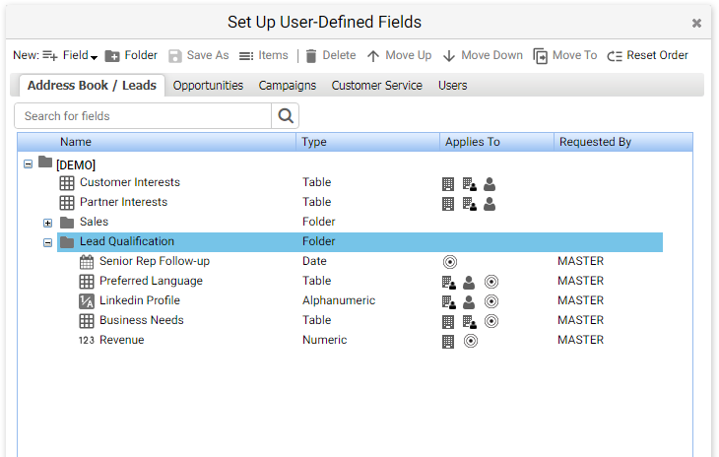
User-defined fields for Address Book entries and leads
In the Address Book / Leads tab, you can identify which fields are for leads only, which one are for Address Book entries and which one are shared between the two modules by looking at the icons in Applies To column.
The user-defined fields for leads can be edited in Add / Edit Lead screen and in Lead Details screen. The user-defined fields can also be edited through Global Edit and can be imported.
Fields for Address Book entries only
Field for leads only
Fields for Address Book entries and leads

Slide 8
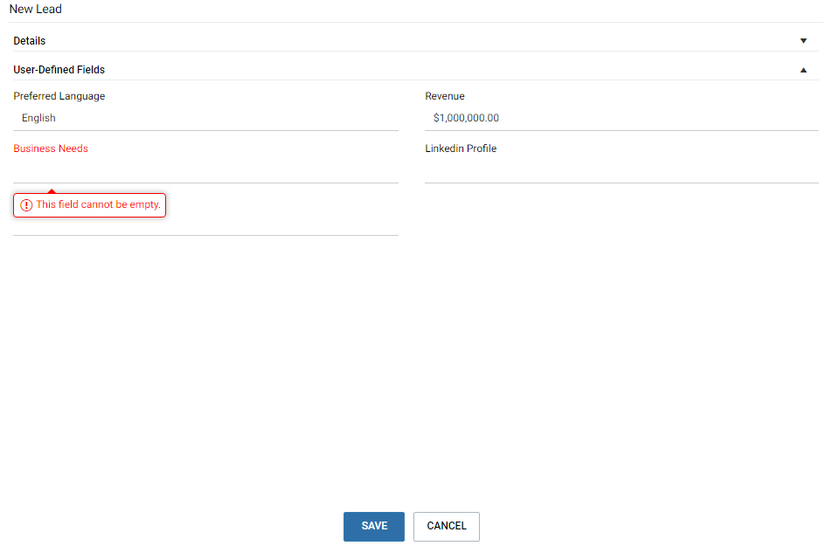
Edit user-defined fields in Add / Edit Lead dialog
Click the arrow button to collapse the Details section so you can access the user-defined fields quickly.
In the dialog for adding or editing a lead, the fields are organized in two sections. The Details section contains the basic fields such as First Name, Last Name, Company, Owner, Process and Stage. The User-Defined Fields section displays all the fields for leads. Key Fields are not supported in this release.
You can collapse the Details section to access the user-defined fields quickly. Checking mandatory fields When you press the SAVE button, mandatory fields will be checked. If any mandatory fields are blank, you will be prompted to enter values in those fields. Keyboard shortcuts You can use the Tab key to go through all the fields. When a drop-down list is selected, press Alt + down arrow to open the list. Press the up or down arrow to select an item in the list. Press Enter key to select an item. To save the entry, press Ctrl + Shift + S. To cancel, press Shift + Esc.
The entry cannot be saved if a mandatory user-defined field is blank.

Slide 9
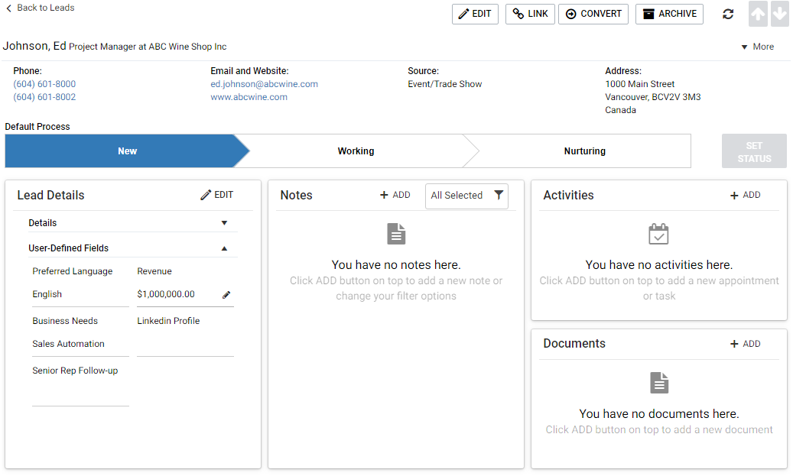
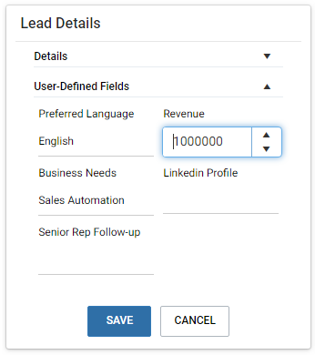
Edit user-defined fields in Lead Details screen
In Lead Details screen, Lead Details widget has been introduced to display the basic fields and the user-defined fields. The widget includes two sections, Details and User-Defined Fields. You can collapse the Details section to access the user-defined fields quickly. In-place-edit in the widget You can edit the fields in Lead Details widget directly. When mouse is over a field, a pencil button will appear. Clicking this button will enable the edit control of the field. You can continue editing other fields. Once you finish editing, press the SAVE button to save all the changes at once.
Note You can also click the EDIT button on top of the widget to enable the edit mode of the widget.
Press the arrow button to collapse the Details section.
Pencil button will appear when mouse is over a field.
Click the pencil button will enable the edit mode of the widget. Edit the fields and press the SAVE button to save all the changes.

Slide 10
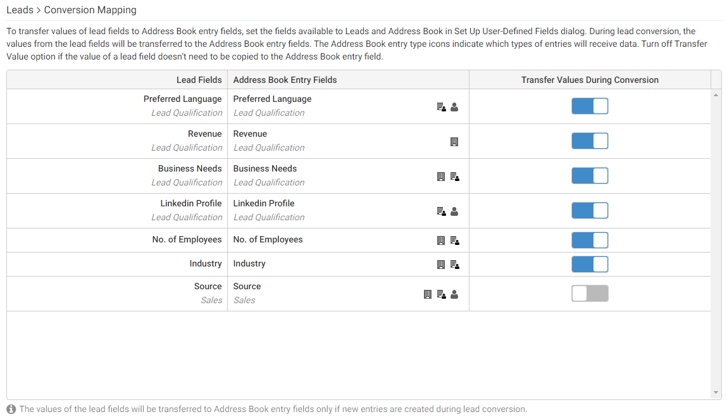
Field Mapping and Data Transfer
To transfer data from a lead to Address Book entries during lead conversion, you need to make the fields available to both leads and Address Book entries. Those fields are mapped automatically.
To view how the data flows from leads to Address Book entries, go to Administration > Settings > Conversion Mapping. The Address Book entry types identify what types of entries will receive data. For example, value of Industry field in leads will be copied to companies and individuals.
If you don’t want to copy value from certain lead fields to Address Book entry fields, you can turn off transfer value option.
Turn off the option if you don’t need to copy the value to Address Book entries.

Slide 11
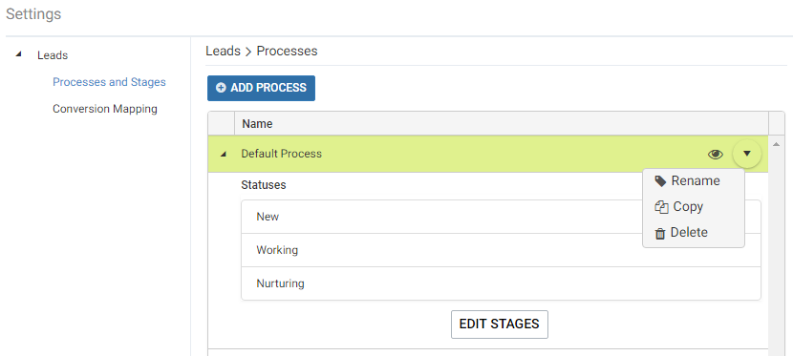
Process and Stage for Leads
In this release, you will be able to create multiple processes to work with leads. Each process contains a set of stages.
To create a process and customize the stages, go to Icon Bar > Administration > Settings > Processes and Stages.
Click the button to open the menu
Click the arrow button or the process name to expand the row and show the stages in this process.
Default Process is the built-in process after you upgrade from the previous version. You can rename this process or create a new process based on this process.
Click the arrow button or the process name to expand the row and show the stages in the process. Click EDIT STAGES button to open the screen for editing the stages.
Press this button to edit the stages.

Slide 12
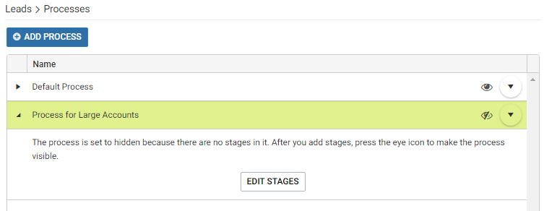
Add a process
To add a new process, Press the ADD PROCESS button.
A new row will be added, enter the name of the process and press SAVE button.
After a process has been created, you need to add stages into it. Click the arrow button or the process name to expand the row and click the EDIT STAGES button.
Note
Before you add stages into a process, it is hidden by default.
Press ADD PROCESS button
Enter a name and press SAVE button
The process cannot turn visible if it doesn’t include a stage.
Click the arrow button or the process name to expand the row. Click EDIT STAGES button to add stages into this process.

Slide 13
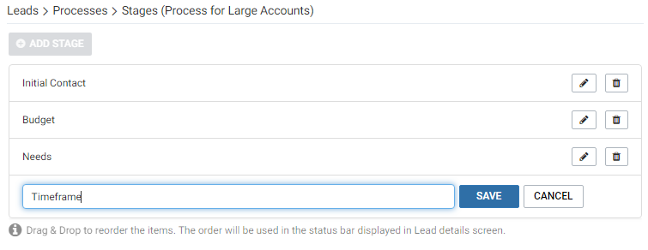
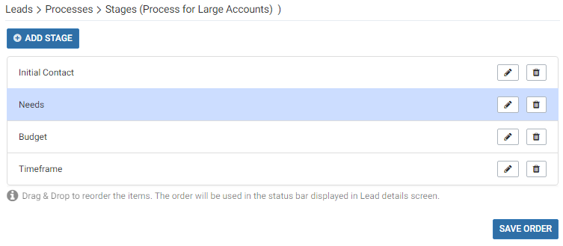
Edit stage
Press ADD STAGE button
To add new stages into a process, click ADD STAGE button.
A new row will be added. Enter the name of the stage and click SAVE button.
After the stages have been created, you can change the order of the stages by drag and drop. To change the name of a stage, press the pencil button. To remove a stage, press the Delete button.
Note
The order of the stages displayed in this screen will be used in the bar in Lead Details screen.
Enter a name and press SAVE button
Change the order of the stages by drag and drop. Press SAVE ORDER button when you finish.

Slide 14
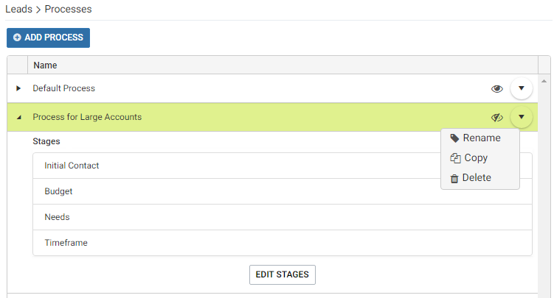
Change, show/hide or delete a process
A new process is not visible by default. When you have finished editing stages, press the eye icon to make it visible.
The visible process will be available in the Process field in Add / Edit Lead dialog.
Clicking the round arrow button will open a drop-down menu where you can find the menu items to rename the process or delete the process. You can also create a new process by copying an existing one. All the stages in the existing process will be copied to the new one.
Note
If a process has been applied to leads, you cannot delete the process. This is to preserve the historical data for reporting. If you don’t need a process anymore, click the eye icon to hide it. The hidden processes won’t be visible to users.
If a process has been applied to leads, you cannot add stages into the process or remove stages from the process. You cannot change the order of the stages either. However, you can rename stages. When you change the name of a stage, it will be applied to all the leads.
Press the eye icon to make the process visible. If you don’t need to use a process anymore, press the icon to hide it.

Slide 15
Work with process and stage
A lead is in Unqualified stage.
The lead life cycle includes three phases.
When leads come in and haven’t been touched by anyone, they will be set as Unqualified by default.
When you start to work with a lead, you can select a process and work through the stages.
Once you complete the process, you will set the lead stage to Converted or Archived.
A process has been applied to the lead. You change the stages while you are working through the process.
Stages
Unqualified |  | System built-in stage (Not customizable) This stage indicates that leads come in but haven’t been touched by anyone.
Default process and stages New Working Nurturing | Custom process and stages Initial Contact Budget Authorization Person Needs Timeline | Default process is the built-in process. It contains new, working and nurturing stages. You can create custom processes and add stages in each process. You can select a process to work with the leads, update the stages as you progress. Once you complete the process, the leads should be either converted or achieved.
Converted |  | System built-in stage (Not customizable) Leads are qualified and converted to customers.
Archived |  | System built-in stage (Not customizable) Leads are discarded because they cannot be converted.
If no process has been applied to a lead, the lead is unqualified.
When you complete the process, you will convert the lead or archive the lead.

Slide 16
Edit process and stage in
Add / Edit Leads screen
In Add / Edit Lead screen, you can select a process in the Process field. The Stage field will be populated based on the selected process.
By default, Unqualified stage is selected.
Select a process from the drop-down in Process field. Only the visible processes will be available in the drop-down.
When a process is selected, the stages in the process will be populated in the Stage field.

Slide 17
Edit process and stage in Lead Details screen
In Lead Details screen, you can select a process if the lead is unqualified.
The lead is unqualified.
Select a process to work with this lead.
The stages of the selected leads are displayed. Click SET STAGE button to commit the change.
Once the changes are saved, you cannot change process in Lead Details screen. You need to click the Edit button to go into the Edit Lead screen and change the process.

Slide 18
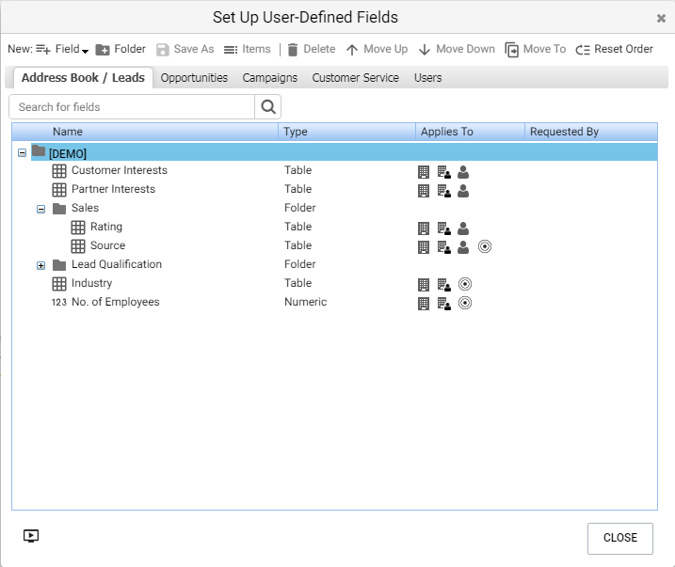
Industry, Lead Source and No. of Employees Fields
In previous release, these fields were system fields for leads. The items in Industry and Source field were not customizable. In this release, these field have been changed to system generated user-defined fields, also known as pre-defined fields. You can edit the properties of these fields the same way as any other user-defined fields in Setup User-Defined Fields dialog. The items in Industry and Source fields can be edited the same way as any other table fields.
These fields are available to both leads and Address Book entries to ensure data being transferred from leads to Address Book entries during lead conversion.
Pre-defined user-defined fields, including Source, Industry and No of Employees, are shared between Address Book entries and leads
Field name and folder | Applies to
\Sales\Source | Companies, Individuals, Contacts and Leads
\Industry | Companies, Individuals, and Leads
\No. of Employees | Companies, Individuals, and Leads

Slide 19
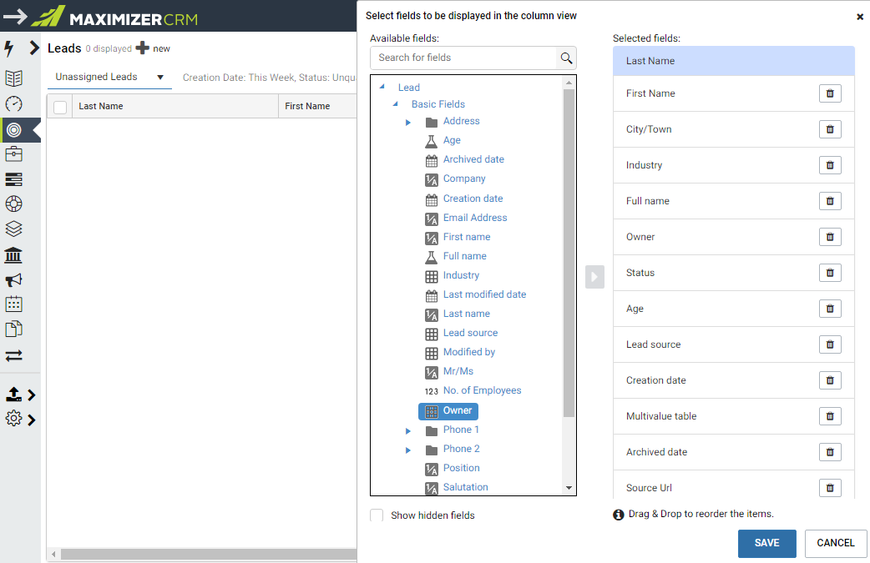
Customize Column View
Open the drop-down menu and click Column Setup.
You can now create your column view in Leads module.
Press the menu button on top-right corner of the Leads screen to open the drop-down and click Column Setup menu item.
A dialog will slide out for you to modify the column view. You can re-order the columns, remove some columns or add new columns.
To remove a column, press the Delete button in the row.
To re-order the columns, drag and drop a column to a new position.
To add a new column, select a field in the Field Picker and press the arrow button. If a field is already in the column view, the arrow button will be disabled.
Note
In this release, you can create one column view for yourself. Your column view cannot be shared with other users.
Select a field in the Field Picker and press the arrow button to add it into the column view. If a field is already in the column view, the button will be disabled.

Slide 20
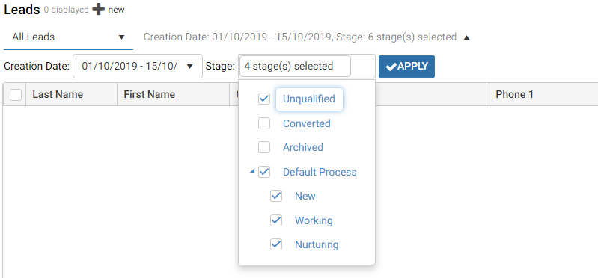
Filter Leads by Stages
In the drop-down for selecting stages, you can select Unqualified, Converted and Archived, as well as the stages from processes.

Slide 21
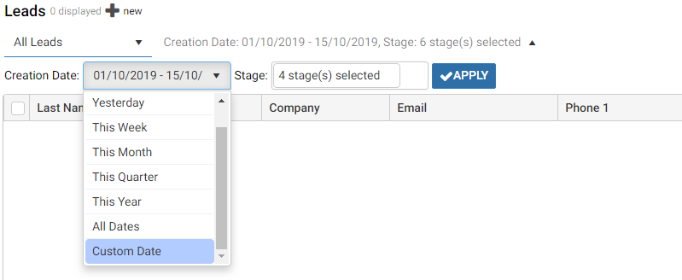
Filter Leads by Date Range
You can now filter your leads by custom date range.
Expand filters and open the Creation Date drop-down.
Select Custom Date
Date pickers will be available for you to select a start date and an end date. Press OK button.
Press Apply button to commit the change.
You can also filter leads created this quarter.
Click the Creation Date field and click Custom Date
Specify the start date and end date, click the OK button
Click Apply button to commit the changes

Slide 22
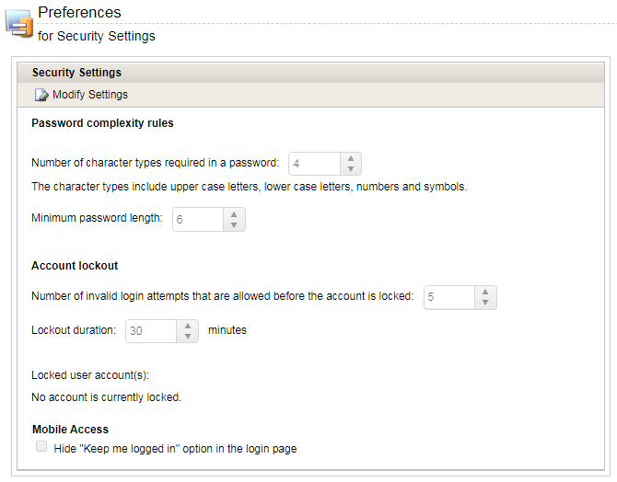
Custom Password Complexity Rules
In this release, the password complexity rule is customizable. There are four types of characters that can be used in passwords, including upper case letters, lower case letters, numbers and symbols. The administrator can specify how many character types need to be used in a password.
To set up the password complexity rule, go to Administrator > Preferences > Security screen. In Password complexity rules section, enter number of character types and minimum length for passwords.
Note
The symbols are not limited to #, _ and $. You can use any symbol.
A password doesn’t need to start with a letter.
The users can use different format for the passwords following the rule. For example, the administrator specify that a password word needs three character types. User 1 creates a password using upper case letter, lower case letters and numbers. User 2 creates a password using lower case letters, numbers and symbols.
If the administrator changes the complexity rule, some user’s password maybe invalid. When the users log in next time, they will be prompted to enter a new password.

Slide 23
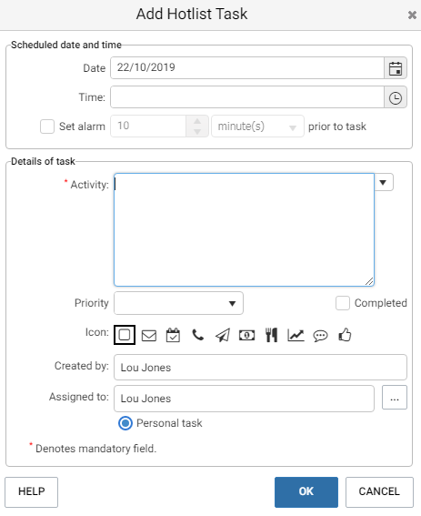
Support More Than 255 Characters in Task Activity Field
Some users want to enter more text into the Activity field in a task. For example, a task is rescheduled and the user wants to enter a note about the reason. Now the Activity field supports 9126 characters. This is supported in the task dialog in Maximizer Web Access, Mobile Access and Outlook add-in.
Note
If a task has more than 255 characters in the Activity field is synced to Outlook, do not modify the Subject field in Outlook task. It will result in text being truncated after the task is synced back to Maximizer from Outlook.
The Activity field supports 9126 characters.

Slide 24
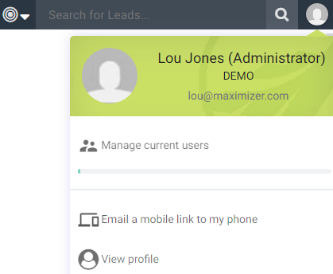
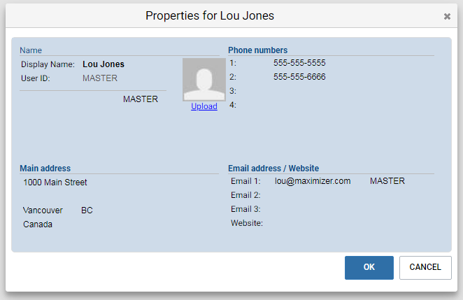
A User’s Primary Email Address Needs to be Unique
After upgrading to 2019 R5 release, each user’s primary email address (email address 1) needs to be unique in one database.
The checking of duplicate email address will be performed in the User Properties dialog and in Administrator.
Go to User Profile drop-down > View Profile and open User Properties dialog. When you press the OK button to save the changes, if the address for email 1 has been used by another user in the same database, you will get prompted and need to enter an unique email address.
In Administrator > Modify User > General Information > General tab, if the address for email 1 has been used by another user in the database, you will get prompted and need to enter an unique email address.
Note
The primary email address cannot be blank.
The email addresses for service users won’t be checked.
Address for Email 1 needs to be unique in one database.

Slide 25
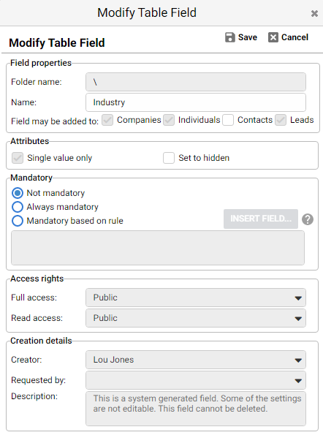
Settings of the System Generated Fields
Maximizer ships some system generated user-defined fields, as known as pre-defined user-defined fields. These fields are created in every new database.
Field name and folder | Applies to
\Sales\Source | Companies, Individuals, Contacts and Leads
\Sales\Rating | Companies, Individuals, and Contacts
\Industry | Companies, Individuals, and Leads
\No. of Employees | Companies, Individuals, and Leads
\Customer Interests | Companies, Individuals, and Contacts
\Partner Interests | Companies, Individuals, and Contacts
The entry types selected by the system are checked and disabled.
Since these are the system generated fields, some of the settings that will affect the whole system are disabled. This is to prevent the users making changes that will affect the built-in functions.
The entry types specified by the system are checked and disabled. For example, in the Industry field, checkboxes for Companies, Individuals and Leads are checked and disabled. The entry types displayed in the table above are checked and disabled in the fields.
“Set to hidden” option is enabled. Other attributes are disabled.
All fields in Access Rights and Creation Details sections are disabled.

Slide 26
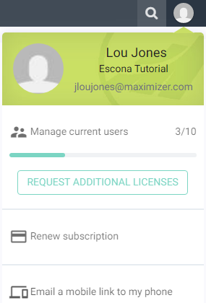
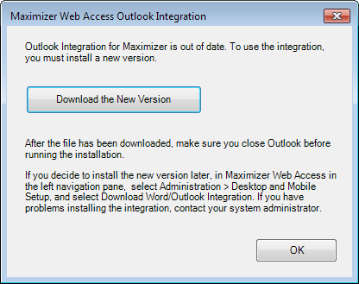
Email URLs for Native Mobile Apps
You can now email the URLs for installing the native mobile apps to you device. The URLs will direct you to the Google Play or Apple Store to download the respective apps. You can send the URLs to your device from User Profile menu or Administration > Desktop and Mobile Setup screen.
New Version of Outlook Add-in
After upgrading to the new release, you need to install the latest version of the Outlook add-in. The new version allows you to specify a process and select a stage when creating a lead based on an email. It also handles more than 255 characters in task Activity field when syncing tasks.

Slide 27
Thank You

